Slide 1
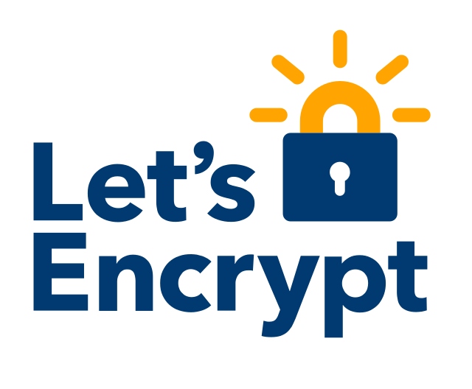
Operating CT Logs
Wins and Woes

Slide 2
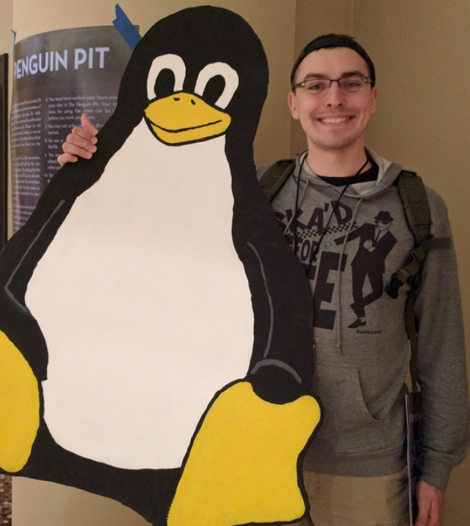
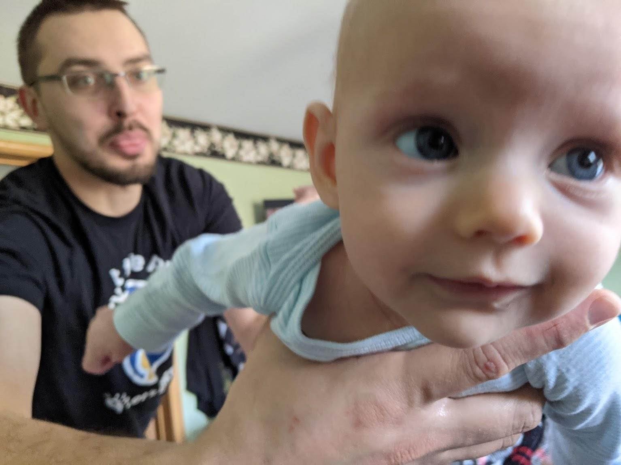
Who am I?
phil@letsencrypt.org
github.com/pgporada
linkedin.com/in/philporada
Notes:
Hi, my name is Phil Porada and I'm a software engineer at Let's Encrypt. Prior to that I was a site reliability engineer for 5 ½ years at Let's Encrypt.
I'm a hobbyist network administrator and systems administrator.
I've got 2 beautiful baby girls at home and a bunch of cats.

Slide 3
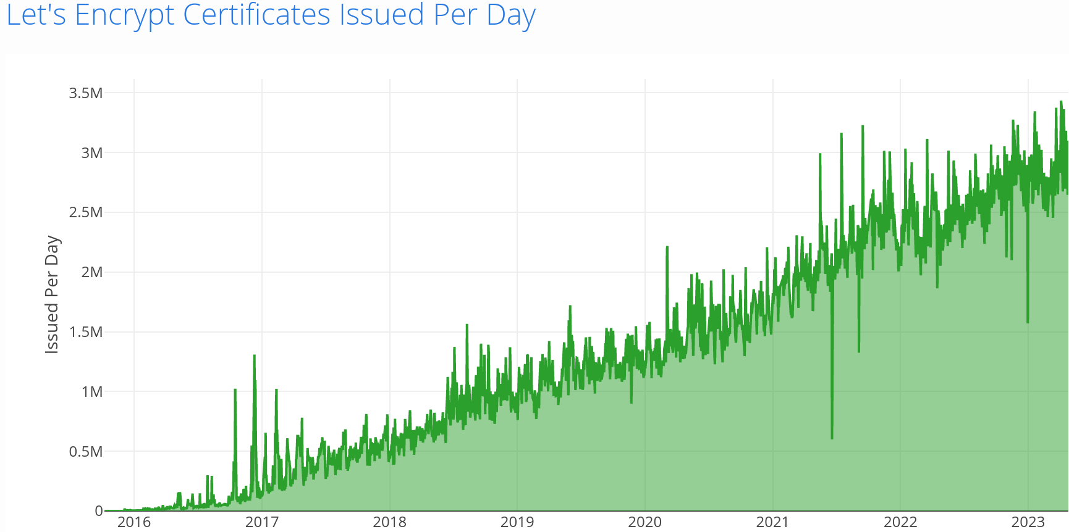
What is Let's Encrypt?
Notes:
Let's Encrypt is a nonprofit Certificate Authority that provides TLS certificates to over 325 million websites. We're supported primarily through corporate and non-governmental organization sponsorship. To date, Let's Encrypt has issued almost 10 million certs for .gr domains (Greece ccTLD).

Slide 4
Blogs we've written about CT
2019
Introducing Oak, a Free and Open Certificate Transparency Log
https://letsencrypt.org/2019/05/15/introducing-oak-ct-log.html
How Let's Encrypt Runs CT Logs
https://letsencrypt.org/2019/11/20/how-le-runs-ct-logs.html
2022
Nurturing Continued Growth of Our Oak CT Log
https://letsencrypt.org/2022/05/19/nurturing-ct-log-growth.html
Notes:
This presentation will be a rehash of these posts with some additional improvements we've made along the way and a few war stories.

Slide 5
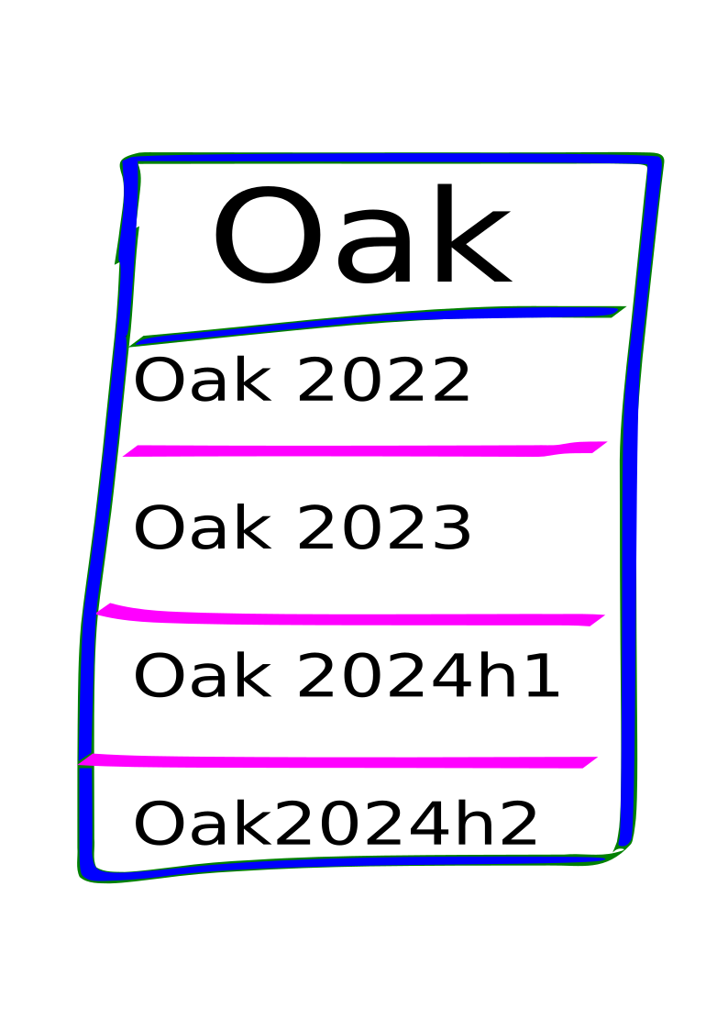
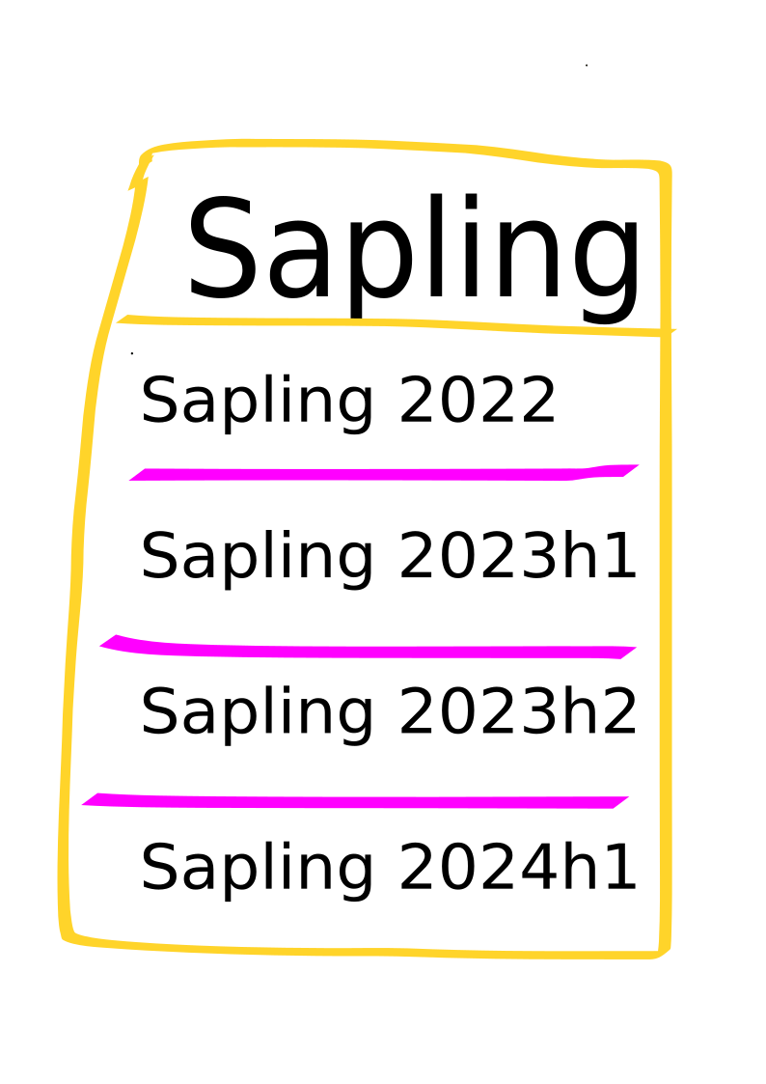
Logs? Shards? Oh my!
Notes:
Each Let’s Encrypt CT log is made up of many individual temporal log shards which are named after a period of time. While each shard is technically a separate CT log sharing the Oak family name, it makes sense to conceptualize shards as belonging to a single log.
Oak 2023 contains certificates which expire in 2023
We've recently deployed shards with a lifetime less than a 1 year lifespan.
Oak 2024h1 accepts certificates issued from December 20, 2023 through July 20, 2024
Oak 2024h2 accepts certs issued from June 20, 2024 through January 20, 2025
Each new shard overlaps with the previous one for a short period while we monitor its performance and ensure correctness. This overlap is a protection against the possibility of any significant downtime as we switch shards since a long period of downtime would make our log unqualified.
There was an incident where Let's Encrypt had a short outage of being unable to fulfill SCT requirements due to a CT log rollover. A log rollover is when our Boulder CA software stops submission to, for instance, Oak 2018 and starts submission to Oak 2019. I think there were 7 of us gathered around a hotel lobby table investigating/running communications/and deploying the fix.

Slide 6
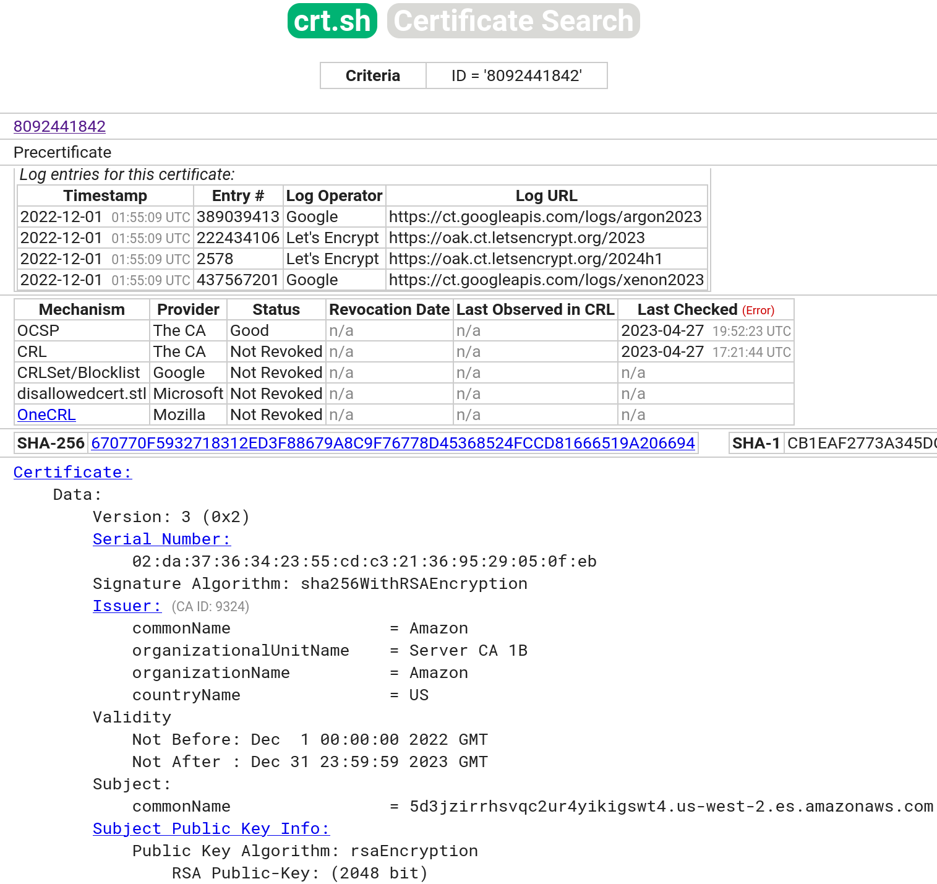
How does a CT log benefit a CA?
Notes:
As a Certificate Authority who also operates Certificate Transparency logs, operating a log helps us take control of our destiny. Apple and Google Chrome require all new Domain Validated certificates to be submitted to two separate logs. By running a CT log, we can fulfill half of that requirement for our organization.
For Organization Validated and Extended Validation certificates, the number of distinct CT logs increases.
Let’s Encrypt often issues more than 3 million certificates each day, so we set out to design a CT log infrastructure that could handle not only our high volume, but for all other publicly trusted Certificate Authorities.

Slide 7
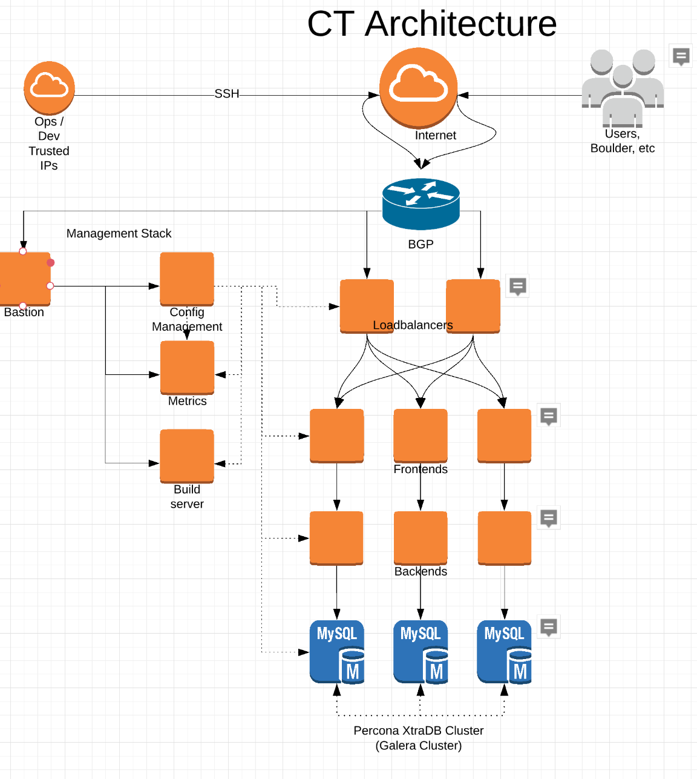
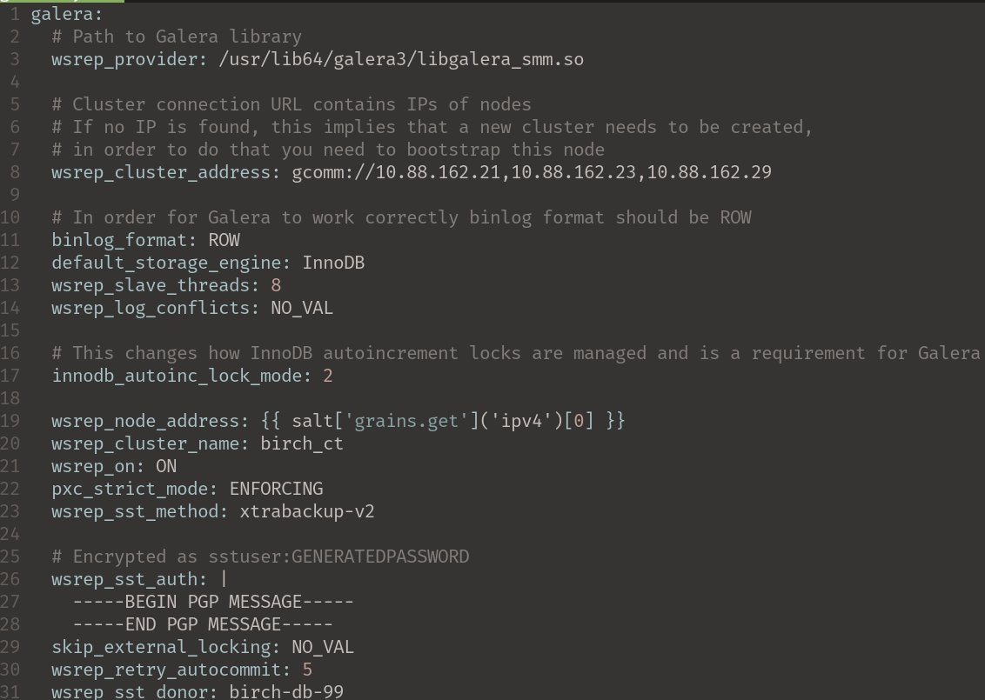
Initial Failed Architectures
Notes:
Sometime back in 2017 we set out to deploy our own CT log. An initial feasibility test was done in AWS with an RDS database and EC2 instances. We had used saltstack to orchestrate much of the setup after learning how the pieces of certificate-transparency-go and trillian fit together. Those logs were then chopped down.
In 2018 we began in earnest to deploy CT logs that we would submit inclusion requests to Apple and Google Chrome. After doing sizing and cost-benefit analysis, we arranged a deal with a physical server host. We used their EC2-esque provisioning system, saltstack for deploying all the different bits, and a MariaDB Galera cluster for storing the Trillian merkle tree.
This particular set of logs was an operational nightmare. We faced alert fatigue and a sense that it wasn't possible to successfully run a qualified log. Problems we encountered were frequent network failures so we implemented a routing system with bird bgp on the front end. This was actually a lot of fun and worked pretty well. We also faced server availability issues. When we would scale down a server, a server in that same class that we expected to be available would sometimes not be which was a huge issue for the Galera cluster because it needs to [maintain a quorum](https://galeracluster.com/library/documentation/weighted-quorum.html#quorum-components).
The Galera cluster itself, when rebuilding a failed database, performs an SST transfer. With a sizeable database, we experienced performance degradation on all shards during these SST transfers and cluster rebuilds. I've got that old Galera config on the screen if you're interested.

Slide 8
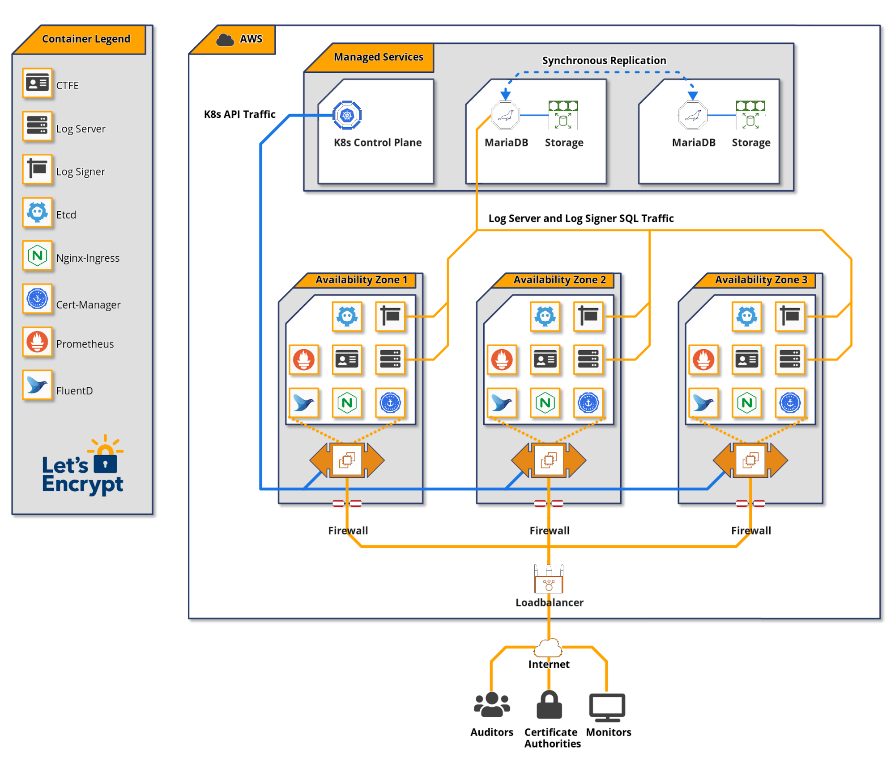
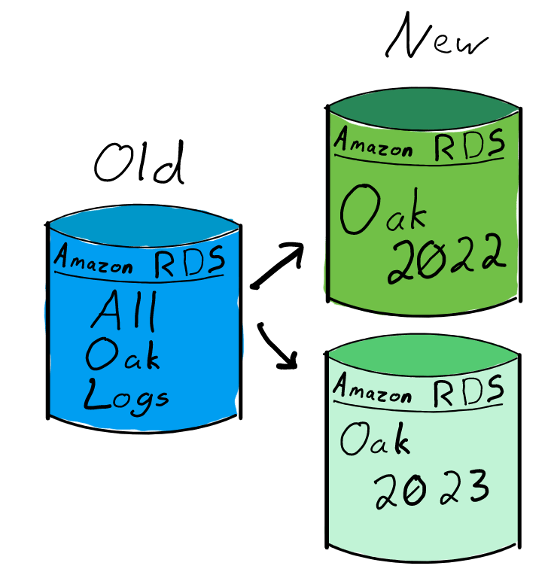
Current Functioning Architecture
Notes:
Our infrastructure has changed slightly since Oak was initially deployed in 2019. Since then we've learned a lot about what not to do and have gained some experience.
The image on the left shows the original architecture diagram I made. While the picture on the right illustrates conceptually how we split apart the MariaDB databases into separate instances for each shard in early 2022.
Primarily the software we're running is Google's certificate-transparency-go, trillian, and ETCD. Amazon handles some aspects of the database for us with RDS. We're still responsible for performance tuning, migrations, and monitoring.
Certificate-transparency-go provides the "personality", or the Golang implementation of RFC 6962, and handles communication with the merkle tree implemented by trillian.
The merkle tree itself is stored in the database. In our case, we use MariaDB for this.
Aside from the containers you see on the screen, we run nginx as a reverse proxy and have it provide path routing.
We run prometheus exporters to scrape metrics from the underlying hosts; databases; and applications, and alertmanager to send alerts to our SRE team based on those metrics.
After running a log for many years, I would like to say that it's hands off, but that's not really the case. It took a lot of hard work to get the Oak log to where it is today. A lot of which relates to database operations.

Slide 9
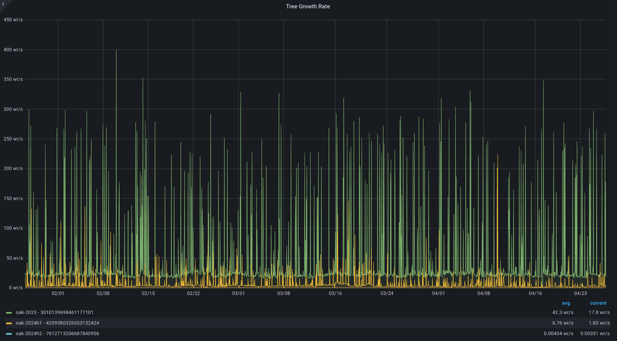
Tree Growth Rate
Notes:
The Oak 2023 shard is currently still accepting certificates issued by Let's Encrypt and therefore services a high volume of requests. You can see the past 90 days of merkle tree growth in this picture.

Slide 10
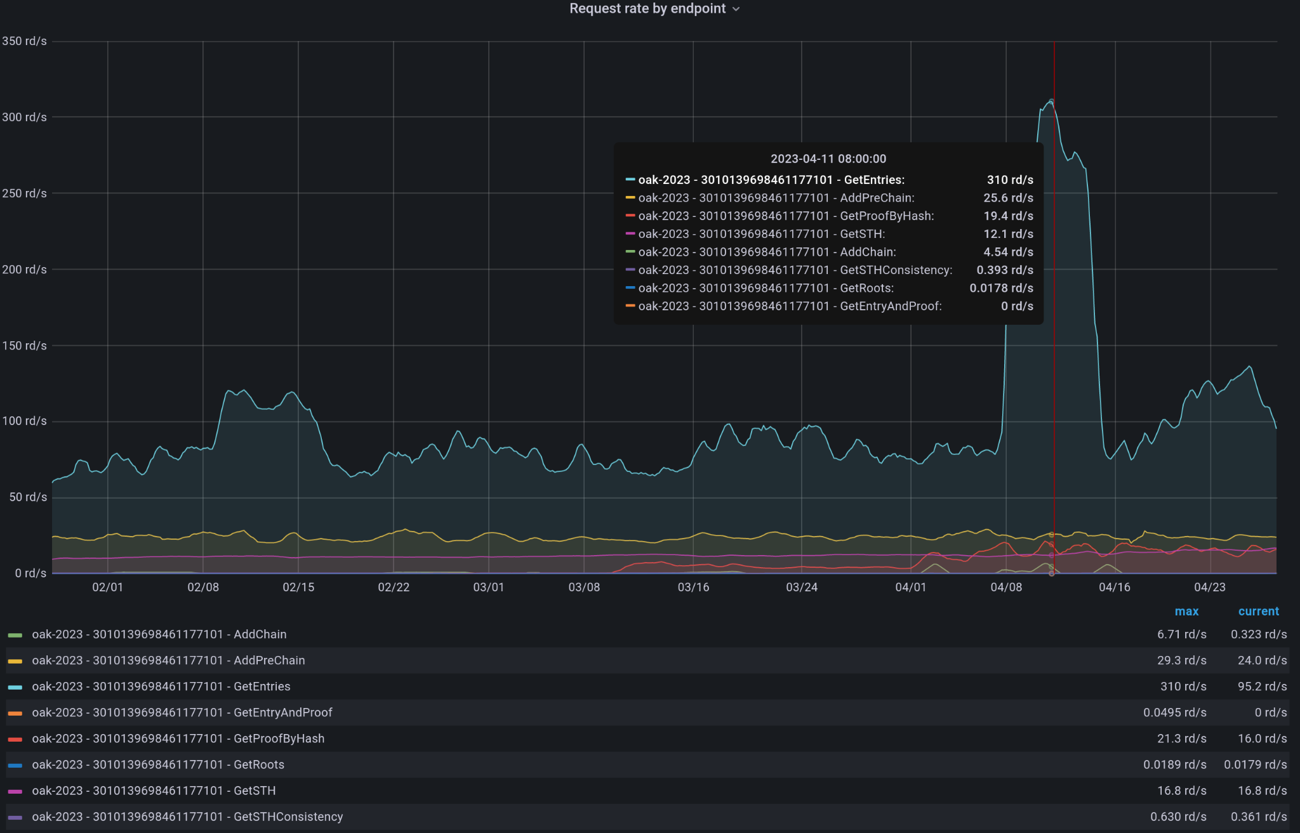
Request rate by endpoint
Notes:
The active shards will be performing a lot of operations.
The majority of traffic we get is actually not from Certificate Authorities, but from researchers, monitors, and mirrors running RFC 6962 get-entries requests.
We return a maximum of 256 leaf entries per get-entries request to limit database row scanning time.
Downloading the whole log tree from the first leaf entry is the most significant demand of disk I/O on the database.

Slide 11
A Fun Incident
Error reproduction: github.com/koshatul/go-mysql-sync-issue
Notes:
Back in August 2020 we performed a routine set of application upgrades and noticed the log line above. Thinking it was a bug, we performed a rollback.
Digging into that warning message with help from Al Cutter on the trillian team revealed that specific warning message sweeps some unrelated, but serious, errors under its rug; most notably Trillian hitting max database connections.
Why was this happening though?
Our initial thought about a trillian bug was incorrect, but it lined up perfectly with our application upgrade.
Turns out that it was a performance problem on our log caused by an abusive client pulling data from every Oak shard. This person was launching multiple short lived AWS EC2 servers to bypass our nginx HTTP GET rate limit of 50 requests per second per IP address. The traffic they generated peaked at 600 HTTP GET requests per second which our database could not handle.
Typically the Oak database during those days handled about 110 HTTP GET requests per second. During the times this person launched their server fleet, Oak would have short outage until they went away. The Oak outage would then cause outages in production CAs; notably Let's Encrypt and Sectigo.
We implemented a few quick mitigations to get Oak back into a functional state.
The first was returning a nasty-gram for the specific useragent and severely rate limit their HTTP GET requests per second.
The second mitigation was to set a global HTTP GET rate limit for all RFC 6962 /get-* endpoints. Certificate Authorities primarily send POST requests to RFC 6962 /add-chain and /add-pre-chain endpoints and would be unaffected by the new rate limit. The intended purpose was to limit the damage that an abusive researcher could do to our log.
The final mitigation was to configure trillian with a max MariaDB connections parameter to limit saturating the database with connections. In the event that a trillian process exceeded its configured database connection limit, the MariaDB driver would wait for an available connection before dropping off with an error to the user.

Slide 12
Cost of running our CT logs
Human
1 - 2x SREs spending ~3 months worth of time over the course of a year
Compute
Compute nodes are basically commodity hardware.
Storage and RAM for compute nodes is also negligible. Just enough to run applications.
Database
This will be your pain point. Horizontal scaling continues to be the solution, and is straightforward to apply
Faster storage will give better log performance to a point when data is read from disk.

Slide 13
Lessons Learned and Takeaways
Have a testing log so you don't prematurely ruin your production log.
Logs are ephemeral. When your log fails, root cause why and build a new better log with the lessons learned.
Don’t be afraid to ask for help. The Trillian team on the GTrillian slack channel and github issues have been very kind and patient.
Separation of concerns: run each binary in a different container, VM, or physical host. You’re after reliability.
The log_signers (sequencers) perform an etcd election to determine which cluster member will communicate with the database. Make an alert if more than 1 cluster member has mastership for a particular shard because it will indicate a split brain scenario and cause an incident. We've been there.
Build a rate limiting story to protect your log.
We don't run database backups for CT logs.
More automation is better than less. That's why we put our logs in Kubernetes.
Notes:
[Skip over the wall of text and so that people can review it at their own leisure later on.]

